Slide 1

Clustering and summarising algorithm

Slide 2

What does the algorithm do
Able to clean the data of unwanted characters words, or slangs
Able to classify or group data based on the same intent
Can summarise those groups of data or create word frequency chart

Slide 3
Applications of our algorithm

Slide 4

Media monitoring
This algorithm can help summarise the information regarding ford on different media sites
This can give us a picture of how the world perceives ford and make any changes accordingly.

Slide 5
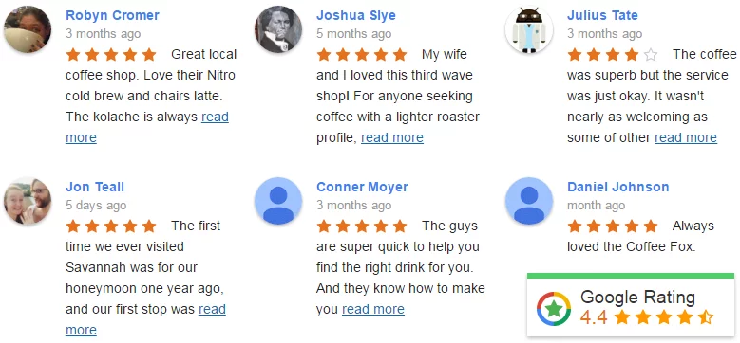
Analysing review sites.
The algorithm will be able to summarise millions of reviews and give a clear idea of what changes majority of the people would like
Ford can than make changes accordingly.

Slide 6
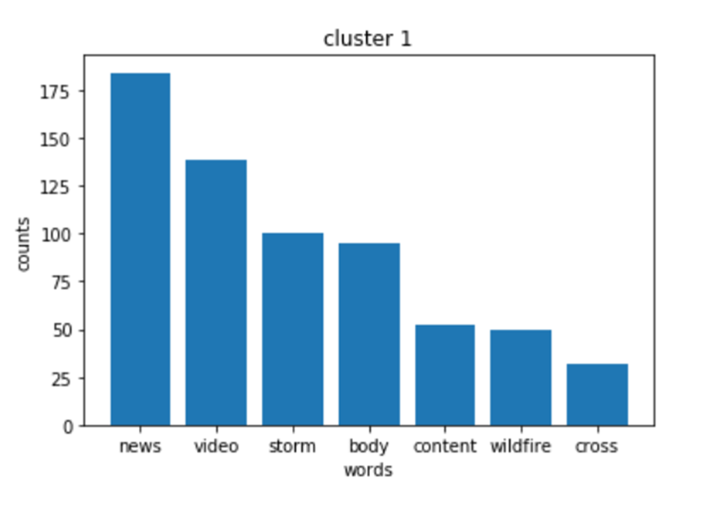
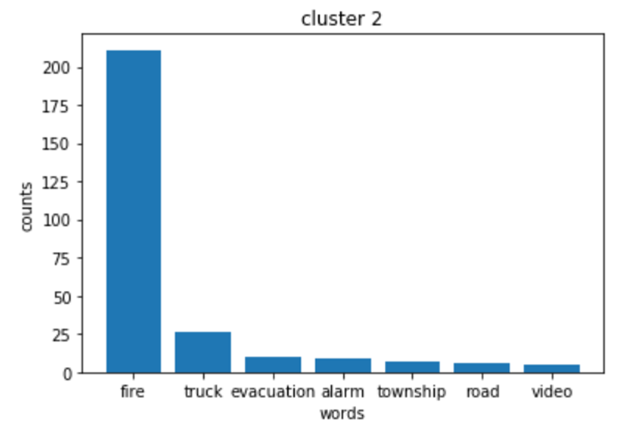
Word count for groups

Slide 7

Financial research
There is only so much that a single person can read and analyse
This algorithm will help by summarising financial market reports, earning reports and financial news everyday. Which can quickly be analysed saving time and money.

Slide 8
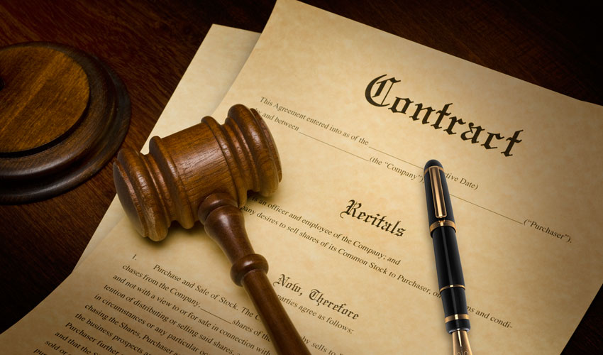
Legal contract analysis
more specific summarization systems could be developed to analyze legal documents
a summarizer might add value by condensing a contract to the riskier clauses, or help you compare agreements.

Slide 9

Email overload
Summarization could surface the most important content within email and let us skim emails faster
It can help remove all the formalities and greeting and unnecessary words so that it can be skimmed through quickly.

Slide 10

Patent research
researching patents can be a tedious process. Whether you are doing market intelligence research or looking to file a new patent
a summarizer to extract the most salient claims across patents could be a time saver.

